Slide 1
Analysis for ACT and SAT
Making recommendations for improving SAT participation rate for a suitable state

Slide 2
Problem statement
Making recommendations for improving SAT participation rate on a suitable state

Slide 3
Workflow
Data and problem statement identification
Exploration
Cleaning
Analysis
Findings
Structured data
ACT datasets for 2017 and 2018
SAT datasets for 2017 and 2018
Identify problem statement based on dataset
Data size
Data formats
Getting domain knowledge of data columns
Value boundaries for numerical columns
Removal of unnecessary symbols
Rectification of erroneous data value
Correction of incorrect data types for statistical processing
Descriptive statistics summary
Generating suitable plots for trend identification
Filtering columns of interests
Research online for identification of causes in trends
Combining analysis and research to make recommendations

Slide 4
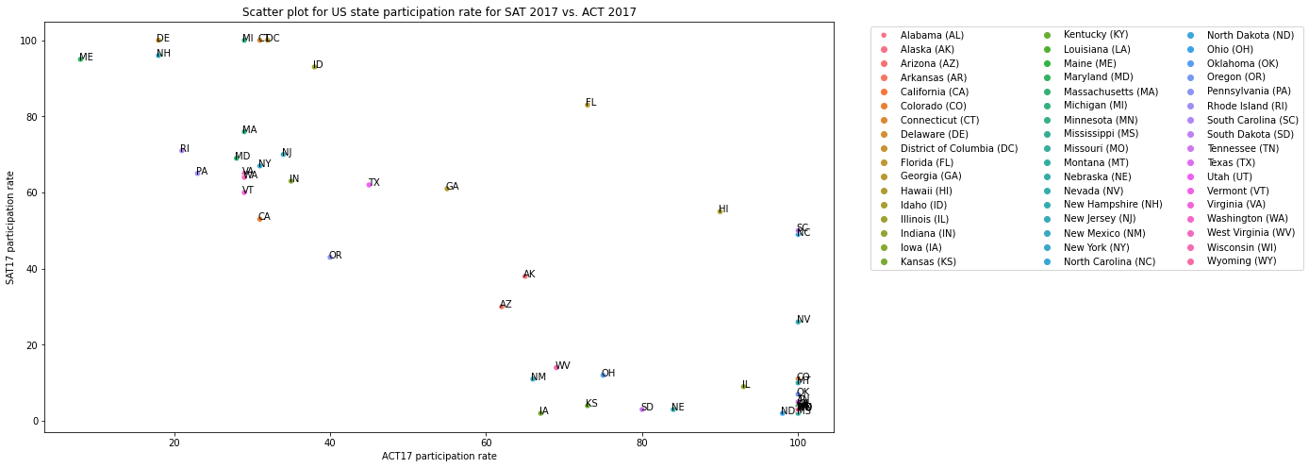
Trend : Negative correlation between SAT/ACT for 2017

Slide 5
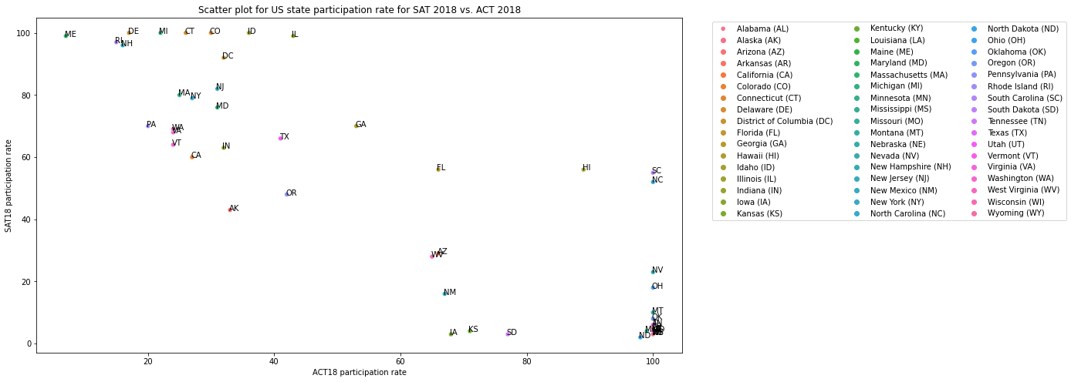
Trend : Negative correlation between SAT/ACT for 2018

Slide 6
State to choose for improving SAT

Slide 7
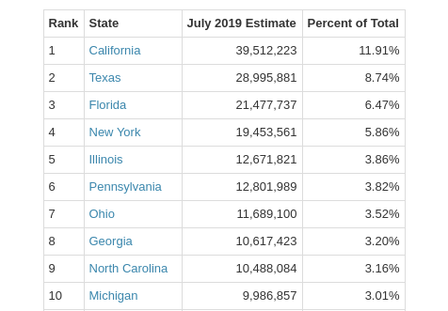
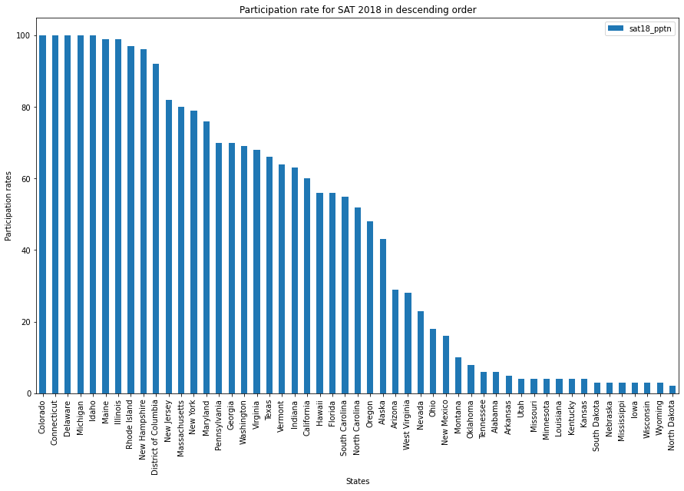
Considerations in choosing California state for improving SAT participation
Population (Most populous state)
No state laws mandating SAT participation
Existing Participation rate
Median
Notes:
References:
Table of state population: Infoplease. (2021). Screenshot of State population table. State population by rank. https://www.infoplease.com/us/states/state-population-by-rank

Slide 8
Recommendations
Replacing California High School Proficiency Examination (CHSPE) with SAT
Legislating SAT as state compulsory exam
Subsidise SAT fees

Slide 9
End

